Slide 1
Smoke-Aware City Forecasting Predicting tomorrow’s PM₂.₅ in Reno, Nevada using open data and machine learning

Slide 2
Problem Statement
Wildfire smoke can significantly affect air quality by increasing levels of small harmful particles called PM₂.₅. These pollution spikes often happen suddenly and without clear warning. My goal in this project was to build a simple prediction system that can forecast tomorrow’s PM₂.₅ levels based on open-source air pollution and fire activity data. A system like this can help local people and health officials prepare for smoky days in advance.

Slide 3
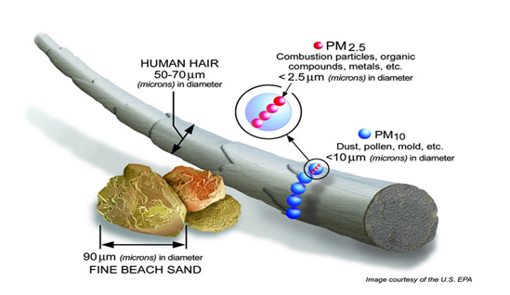
What is PM₂.₅ and Why Is It Dangerous?
PM₂.₅ stands for “particulate matter that is smaller than 2.5 micrometers,” which is about 30 times thinner than a human hair. Because these particles are so tiny, they can go deep into the lungs and even enter the bloodstream. PM₂.₅ is especially harmful for people with asthma, heart disease, or lung conditions, but long-term exposure is unhealthy for everyone. High levels of PM₂.₅ are often caused by wildfire smoke, car traffic, and wood burning.

Slide 4
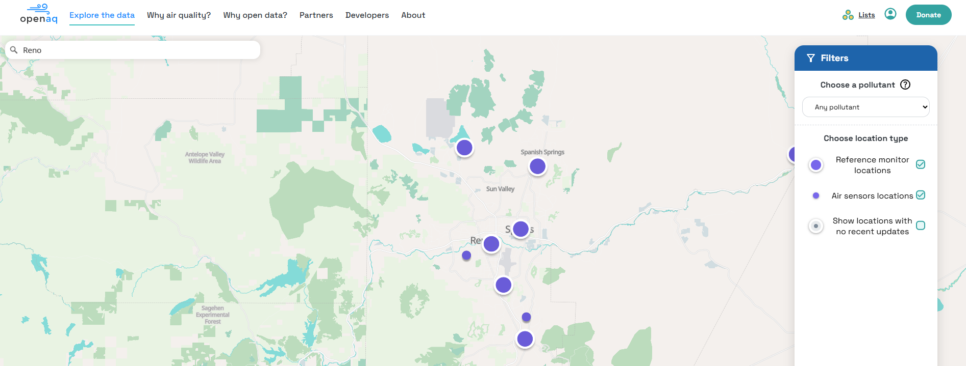
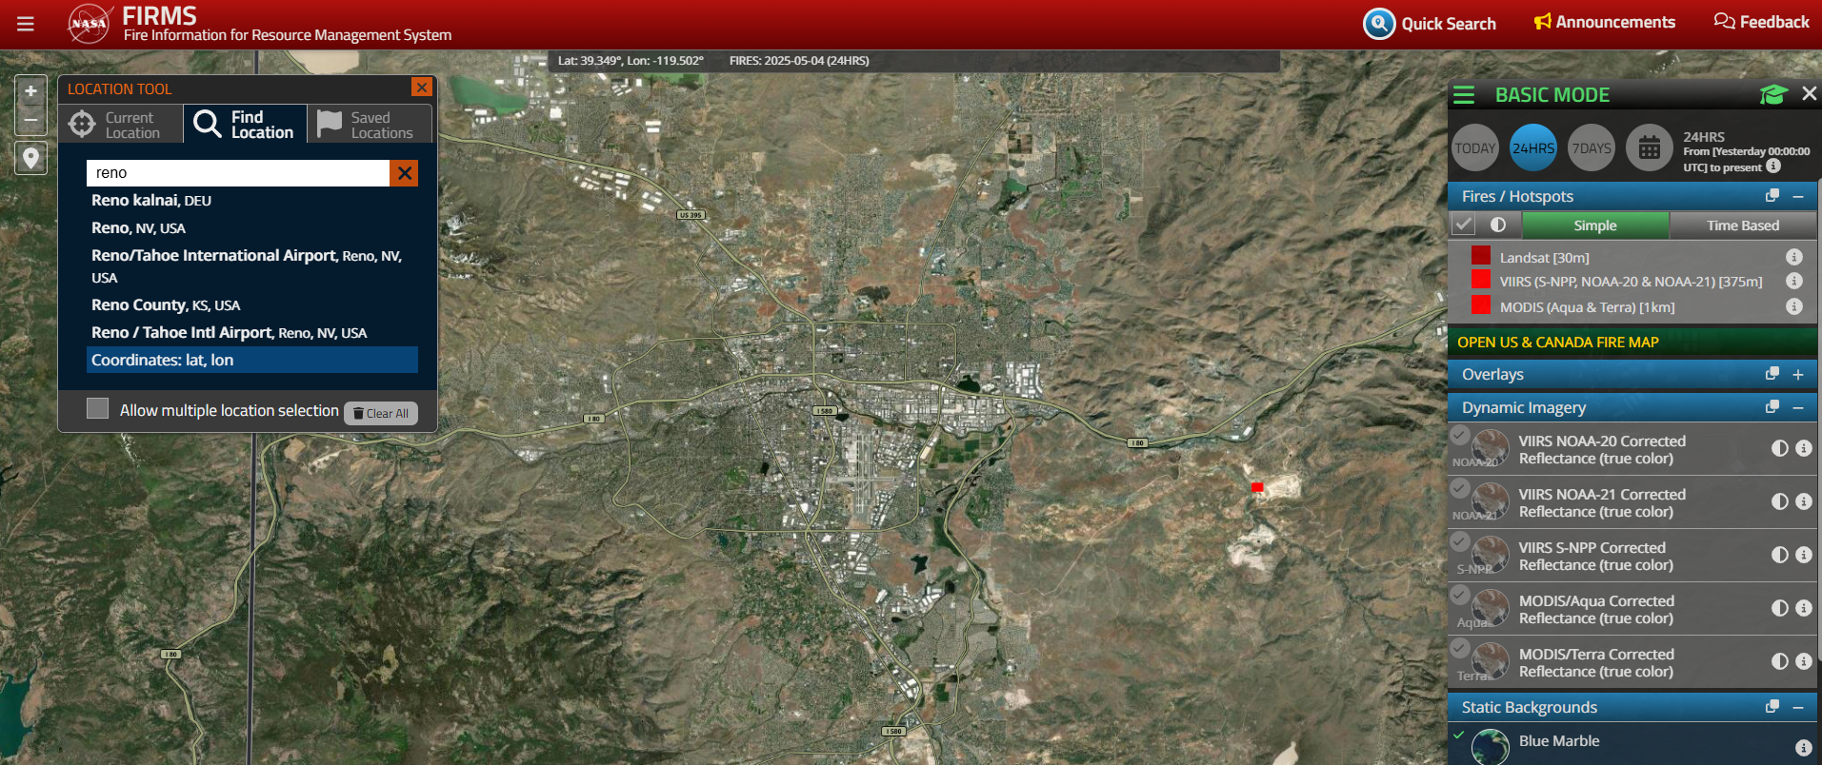
Where I Got My Data
For this project, I used two free and open data sources. First, I collected hourly PM₂.₅ measurements from OpenAQ, which is a platform that provides real-time and historical air quality data from cities all over the world. Second, I used fire activity data from NASA’s MODIS satellite, which detects and counts fire “hotspots” from space. I filtered the satellite data to focus only on fires near Reno, using a box around the city that’s about 300 kilometers wide.

Slide 5
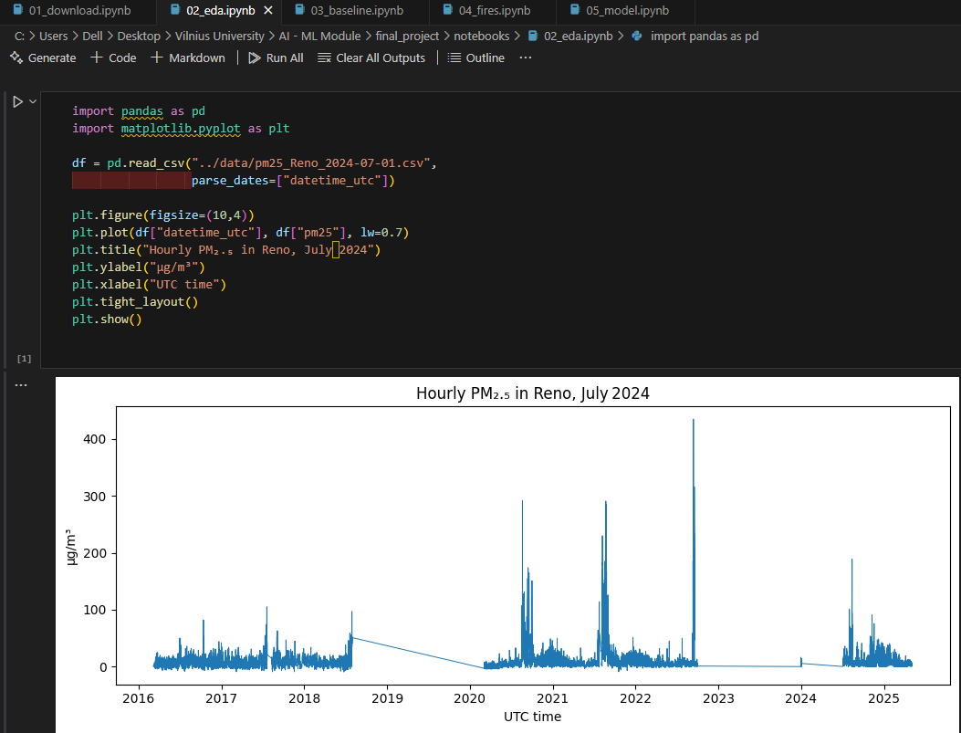
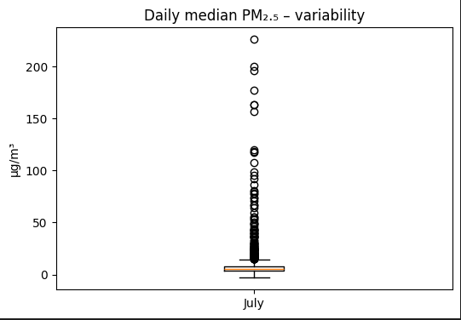
What Steps I Did With the Data
In my results, the baseline model gave a mean absolute error (MAE) of 3.91 µg/m³, which means on average it was about 4 units off from the true value. The Random Forest model performed much better, with an MAE of 1.72 µg/m³ — less than half of the baseline error. This shows that using fire activity as a feature improves predictions a lot. Even with only two simple inputs (yesterday’s pollution and today’s fires), we can make much more accurate forecasts for air quality.

Slide 6
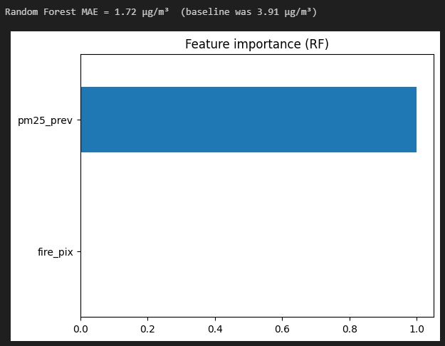
What My Results Show
In my results, the baseline model gave a mean absolute error (MAE) of 3.91 µg/m³, which means on average it was about 4 units off from the true value. The Random Forest model performed much better, with an MAE of 1.72 µg/m³ — less than half of the baseline error. This shows that using fire activity as a feature improves predictions a lot. Even with only two simple inputs (yesterday’s pollution and today’s fires), we can make much more accurate forecasts for air quality.

Slide 7

What I Learned and What Could Be Improved :
I learned that satellite fire data is a strong early signal for pollution and can be used to predict harmful smoke days. The model I used is small and simple but still gives helpful results — it could be used by local governments or weather apps to provide alerts. In the future, I would like to add weather data such as wind direction and speed, since wind can carry smoke over long distances. I could also try improving the model by adjusting its settings or testing other types of algorithms.

Slide 8
THANKS FOR YOUR ATTENTION

